Slide 1


ImprESS Project
Improving Academic and Professional Education Capacity in Serbia in the Area of Safety & Security (by Means of Strategic Partnership with the EU) - IMPRESS
586410-EPP-1-2017-1- RS-EPPKA2-CBHE-JP
КРИМИНАЛИСТИЧКО ПОЛИЦИЈСКА АКАДЕМИЈА
Academy of criminalistics and police studies
БЕОГРАД, 2017

Slide 2
Basic information
Contract number 586410-EPP-1-2017-1-RS-EPPKA2-CBHE-JP (2017-3214/001-001)
Project acronym ImprESS
Project title: Improving Academic and Professional Education Capacity in Serbia in the area of Safety & Security
Project duration 15th October 2017 - 14th October 2020
Partnerme ERASMUS + Capacity-building in Higher Education, Call for proposals EAC/A03/2016
Total cost 997,300.00 €
Coordinator Kriminalističko – policijska akademija, Cara Dušana 196 Beograd, Zemun
Project website www.impress.kpa.edu.rs
Project e-mail impress_project@kpa.edu.rs

Slide 3
Consortium
Partner | WP number | Type of partner
The Academy of Criminalistic and Police Studies, KPA | WP1, 6, 8 | Partner country
University Educons, UESK | WP | Partner country
University of Belgrade, UB | WP2 | Partner country
Metropolitan University, BMU | WP | Partner country
University of Defence in Belgrade, UNID | WP | Partner country
Steinbeis Advanced Risk Technologies Institute doo, R-Tech KG | WP7 | Partner country
STEINBEIS-HOCHSCHULE BERLIN GMBH, SHB | WP | Program country
Sant'Anna School of Advanced Studies (SSSA) - Institute of Management (IdM), SSSUP | WP | Program country
The Main School of Fire Service, SGSP | WP3, 4 | Program country
University of Stuttgart, USTUTT | WP | Program country
ATRISC | WP5 | Program country

Slide 4









Respectable logos of the Partners
Improving Academic and Professional Education Capacity in Serbia in the Area of Safety & Security (by Means of Strategic Partnership with the EU) - IMPRESS

Slide 5
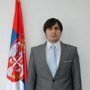
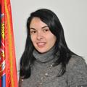
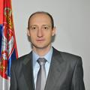
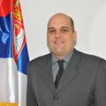
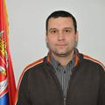

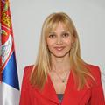
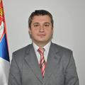
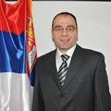

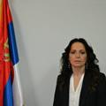
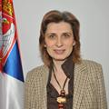
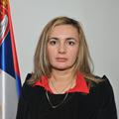
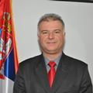
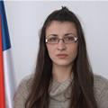
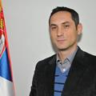
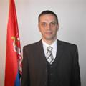
Management team
Improving Academic and Professional Education Capacity in Serbia in the Area of Safety & Security (by Means of Strategic Partnership with the EU) - IMPRESS
Academy of Criminalistics and Police Studies, Belgrade
Improving Academic and Professional Education Capacity in Serbia in the area of Safety & Security ImprESS (586410-EPP-1-2017-1-RS-EPPKA2-CBHE-JP (2017-3214/001-001))

Slide 6
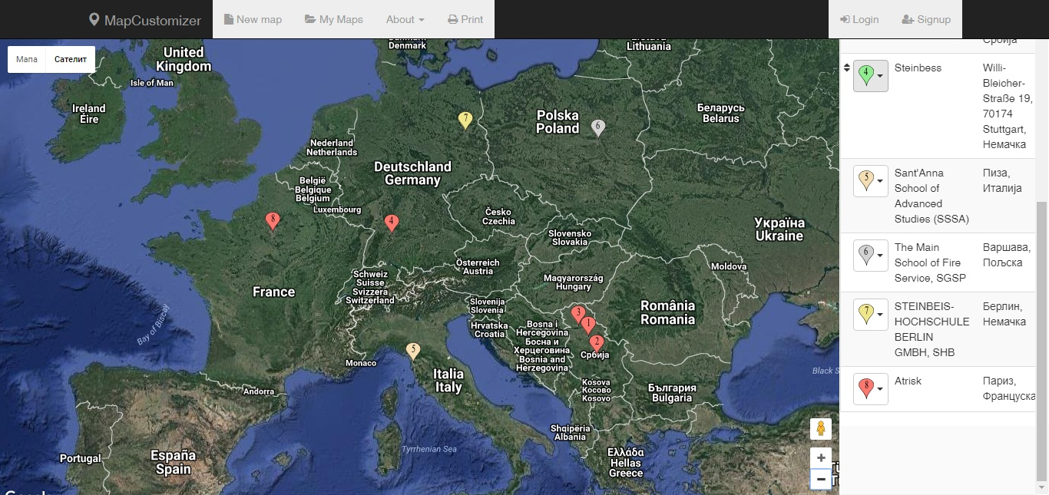
ImprESS map
Improving Academic and Professional Education Capacity in Serbia in the Area of Safety & Security (by Means of Strategic Partnership with the EU) - IMPRESS

Slide 7

Aims and Objectives
Improving Academic and Professional Education Capacity in Serbia in the Area of Safety & Security (by Means of Strategic Partnership with the EU) - IMPRESS
Improving of the academic education capacity in Serbia.
Enhancement of the capacity building
Goals are sublimated in tree major deliverables:
  D1: COURSES & STUDY MODULES – based on the Study Partner in the area of Safety & Security successfully leaded by European Universities (Germany, Italy, France, Poland) will be included into curricula of Serbia’s universities.
  D2: REGIONAL CENTER FOR TRAINING & EDUCATION IN THE AREA OF SAFETY & SECURITY (TESS) – creating a platform where Serbian’s students will be able to acquire experience in a practical way by attending workshops, simulation exercises including usage of the most advanced techniques & technologies in the area (agent-based modelling, data mining, web semantics, image processing, AI, interactive visualization, etc.).
  D3: MODEL FOR THE OTHER UNIVERSITIES with results and experiences coming from the project (in line with the EU law regulations) which allow to organize trainings to improve quality of learning and ensure better preparedness for future specialists when dealing with natural and man-made disasters (including also industrial accidents).

Slide 8
Project management structure
Improving Academic and Professional Education Capacity in Serbia in the Area of Safety & Security (by Means of Strategic Partnership with the EU) - IMPRESS
EU
Sant' Anna School of advanced studies
The main school of fire service Leader WP3, 4
Project coordinator KPA
Leader WP1, 6 and 8
University of Belgrade FB
Leader WP2
University of defense
Educons
Metropolitan
Steinbeiss KG Leader WP7
Steinbeis Hohschule Berlin
Univeristy of Stuttgart
Atrisc
Leader WP5
Project contractor

Slide 9
Organizational structure
Improving Academic and Professional Education Capacity in Serbia in the Area of Safety & Security (by Means of Strategic Partnership with the EU) - IMPRESS
Project coordinator KPA
Steering committee
WP1, 6, 8
Manager KPA
WP2 UB/FB
WP 7 Steinbeiss KG
Project executive commitee
WP 3, 4 The Main School of Fire Service (SGSP), Poland
WP 5 Atrisc
Quality champions committee

Slide 10
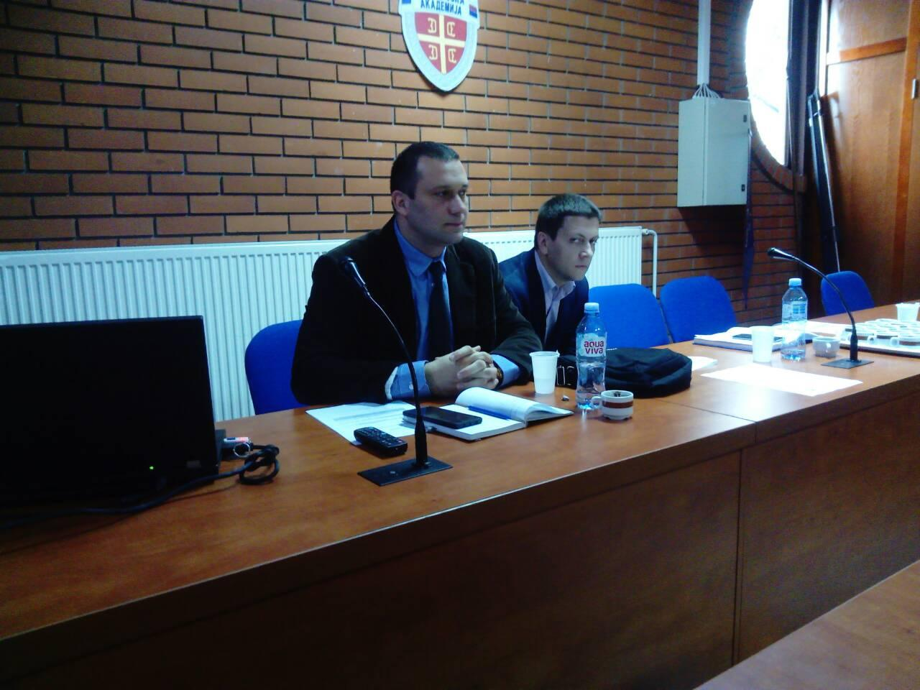
Management documents
Improving Academic and Professional Education Capacity in Serbia in the Area of Safety & Security (by Means of Strategic Partnership with the EU) - IMPRESS
Management guidelines
Administrative guidelines
Quality Plan proposal
PA and other
Non-disclosure agreement
Contingency plan...
Change management
WDT, LMF, WP
Improving Academic and Professional Education Capacity in Serbia in the area of Safety & Security ImprESS (586410-EPP-1-2017-1-RS-EPPKA2-CBHE-JP (2017-3214/001-001))

Slide 11
Activities
WP1 - PREPARATION
Activity | Result | Due date
T1.1 Kick-off workshop (Pre-negotiation) | Report and negotiations for PA | 12/18/2017 17:00
T1.2 Analysis of current undergraduate, masters, PhD and specialized programs and courses curricula in program and partner countries | Report on analysis | 3/16/2018 17:00
T1.3 Workshop(s) with similar projects in Serbia (like K-force, OpenScience….) | Report | 1/15/2018 17:00
T1.4 Technical assessment of available hardware and software | Report | 2/15/2018 17:00
T1.5 Analysis of innovative actions that can be performed | Report | 2/15/2018 17:00
T1.6 Detail plan & execution development workshop | Plan and execution started | 12/18/2017 17:00
T1.7 Quality plan development | Exchanged with partners | 4/16/2018 17:00
T1.8 Drafting procurement documentation | Preparation on it negotiation ongoing | 5/1/2018 17:00
T1.9 Joint procurement of the equipment and software | Waiting for 1.8 to be finished | 9/7/2018 17:00

Slide 12
Activities
WP2 - MODEL FOR IMPROVING THE EDUCATIONAL CAPACITY IN THE AREA OF ’’SECTOR SKILL ALLIANCE’’ FOR SAFETY & SECURITY |  | 1/16/2018 8:00
T2.1 Analyses of EU regulation | Report | 1/16/2018 8:00
T2.2 Analyses of Serbian regulation | Report | 1/16/2018 8:00
T2.3 Model development |  | 7/31/2018 8:00
T2.4 Bilateral and other agreements development and signing | Number of documents signed | 10/31/2018 8:00
T2.5 Model dissemination |  | 10/31/2018 8:00

Slide 13
Activities ongoing
WP5 - ESTABLISHING THE TRAINING AND EDUCATION SAFETY & SECURITY CENTER IN SERBIA | 2/16/2018 8:00
T5.1 The TESS specific domain of applicability | 2/16/2018 8:00 | 5 risks cowered with simulation tools
T5.2 Hardware and Software equipment in the TESS | 2/16/2018 8:00 | 20 working stations; 5 simulation software implemented
T 5.3 Training of the Serbian lecturers | 1/1/2019 8:00 | 5 lecturers trained (20 in total See T. 3.5)
T5.4 TESS Courses and Trainings | 1/1/2019 8:00 | 5 simulation exercises developed and implemented
T5.5 The TESS management structure | 1/1/2019 8:00 | Management structure created. Agreements signed
T5.6 Developed plan for the TESS sustainability | 10/1/2019 8:00 | Plan submitted

Slide 14
Activities ongoing
WP6 – QUALITY PLAN | 10/16/2017 8:00
T6.1 Quality Champions Appointment |  | Every partner appointed 1 quality champion
T6.2 Development of Quality Assurance mechanisms and procedures | 4/17/2018 8:00 | Alignment and optimisation of administrative procedures; Documents and forms development; Process flow dijagrams development; Use of KPI system for tracking activities and outputs; Use of project management tools
T6.3 Monitoring & Evaluation | 6/18/2018 8:00 | At least 6 surveys about quality; Monthly, 6 monthly and yearly evaluation
T6.4 Learning material peer review | 10/1/2019 8:00 | Published learning material reviewed; Maximum 3% of the selected materials for peer reviewing found unacceptable.
T6.5 Document management | 6/18/2018 8:00 | Procedures and flow diagrams developed; Minutes from meetings present Attendance list from events present
T6.6 Quality Reporting | 6/18/2018 8:00 | At least 6 quality reports written and presented. List of decisions made and reported

Slide 15
Dissemination
WP7 – DISSEMINATION & EXPLOITATION | 10/16/2017 8:00
T7.1 Dissemination plan creation | 10/16/2017 8:00 | Plan submited
T7.2 Development of the ImprESS Website (activity split in two) | 10/16/2017 8:00 | Website in operation from 15 February. Informativnes on the level of best similar project sites
T7.3 Maintenance and promotion of the ImprESS Website | 3/16/2018 8:00 | 99% time available; links to all partners websites; 10000 website visitors during project lifetime; 100 questions asked and answered; Annual reports on number of graduates from HEIs as well as trainers and professionals educated and trained in the Training Centre;
T7.4 ImprESS social network communicationPlan submitted; | 3/16/2018 8:00 | 1000 followers on social media
T7.5 Use & Link to already developed EU tools | 3/16/2018 8:00 | Links established
T7.6 Opening and maintenance of e-library public access area | 3/16/2018 8:00 | Established and maintained
T7.7 Perform media, enrolment and promo campaigns | 3/16/2018 8:00 | 10 TV appearances; Partner campaigns; Positive response in media; News about project published with no influence from the project side; Positive response from government and companies
T7.8 Organize ImprESS symposia and workshops | 10/1/2019 8:00 | 1 Symposia organised; At least 70 symposia participants out of which at least 10 from companies or government; 3 workshops held
T7.9 Exploitation plan | 6/1/2020 8:00 | At least 5 companies and 2 government bodies request for meeting

Slide 16
Management
WP8 – MANAGEMENT | 10/16/2017 8:00
T8.1 Established the project management bodies and adopted procedures for efficient project management | 10/16/2017 8:00 | All bodies functioning
T8.2 Risk management | 10/16/2017 8:00 | Project management bodies established and procedures & rules for efficient project management adopted. Roles and responsibilities and relevant management procedures for the successful realisation of tasks discussed and established (RACI matrixes in place). Tasks performed on time and within budget. The Partnership Agreement (PA) signed.
T8.3 Administrative and financial project management | 12/19/2017 8:00 | Project risk register established. Risk mitigation procedure in place. Risk reduction meetings number and results. Executive committee and Steering committee resolutions.
T8.4 Administrative and Financial Stuff Training | 12/19/2017 8:00 | Reporting on time and managed according to Agency rules.

Slide 17
Things learned
Improving Academic and Professional Education Capacity in Serbia in the Area of Safety & Security (by Means of Strategic Partnership with the EU) - IMPRESS
From meeting with the office Giulia moro
FROM neo office in Serbia
From other projects
From disobedience
From best Practices
From ourselves

Slide 18
Requests
Improving Academic and Professional Education Capacity in Serbia in the Area of Safety & Security (by Means of Strategic Partnership with the EU) - IMPRESS
From other projects
  Natrisc
  K-force
  ISEEC
  others
From us to other projects

Slide 19
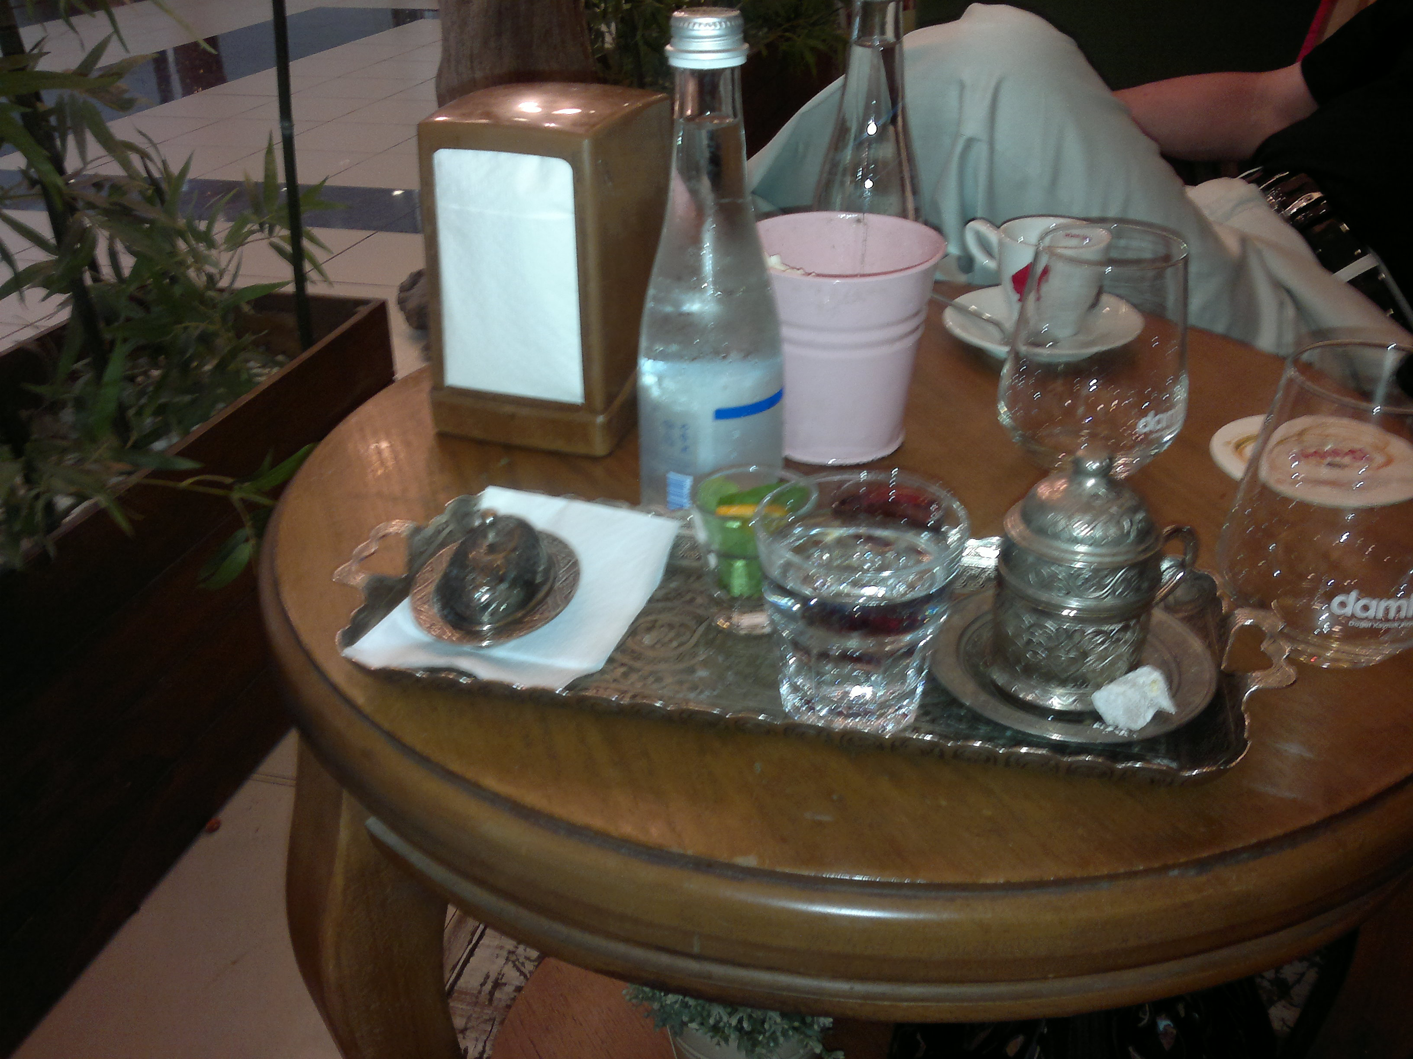
Thank you for your attention

